Slide 1
Tamil OCR Post Processing
2013103047 Sai Mageshvar C S
2013103550 Mathan Pandi P
2013103564 Sidharth Yatish M

Slide 2
Introduction
Documents stored as papers are in need to be digitized for future reference. This can be obtained by scanned copies of such documents.
There is a need of editable text from this image file so that the text can be reproduced somewhere else.
This can be obtained by process of OCR (Optical Character Recognition) that extracts text from an image.
The text so obtained will contain lot of errors arising from the bad quality of image and false character prediction by the OCR and requires post processing.

Slide 3
Need for the system
Documents are being digitalized for future reference which is error prone.
This process requires lot of human effort in correcting the errors.
Such errors cannot be corrected with accuracy
For a language such as Tamil, it is difficult to design such a system due to its morphological nature and wide range of phonetics
This system simplifies the process of contextual text editing

Slide 4
Problem statement
To correct the errors produced by a Tamil language OCR.
It takes the output from OCR software as input and corrects the errors that arises in the process of extraction of editable text from a scanned image document.
To design a Morphological Analyser to find incorrect words in a document and Tamil Grammar rules are used to correct Ottru and Sandhi errors.
An n-gram probabilistic model is to be constructed at the word level to validate correct sequence of text.

Slide 5
Literature survey
Rajeswari Sridhar, Remitha Rathi L, Rithya P, Nivrutha P “Use of Tamil Grammar Rules for Correcting Errors in Optical Character Recognized Document” ,proposed at 12th international Tamil Internet Conference,2013
Concepts taken: Ottru correction, morphological analyzation

Slide 6
Improvements from previous work
Usage of trigram instead of bigram
Increase of n-gram =>increase in efficiency
Increase in set of suffixes
Outputs from multiple OCR software

Slide 7
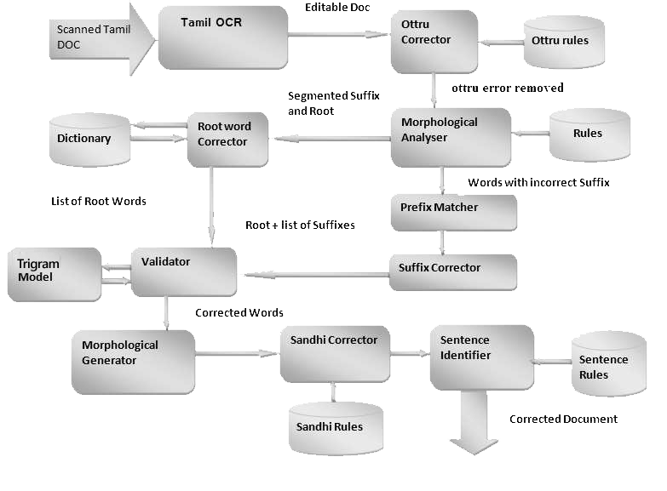
Block Diagram

Slide 8
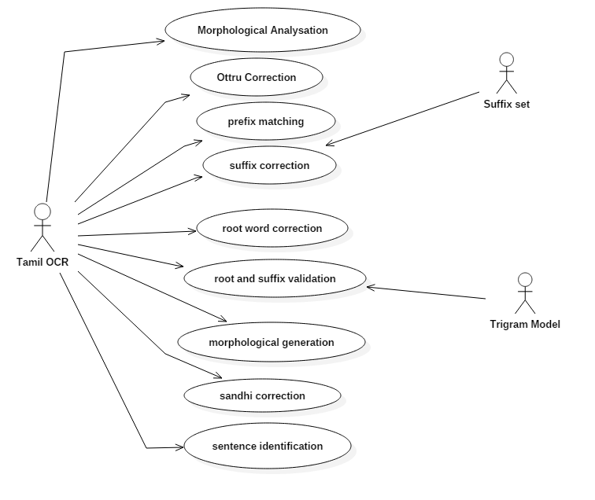
Use case diagram

Slide 9
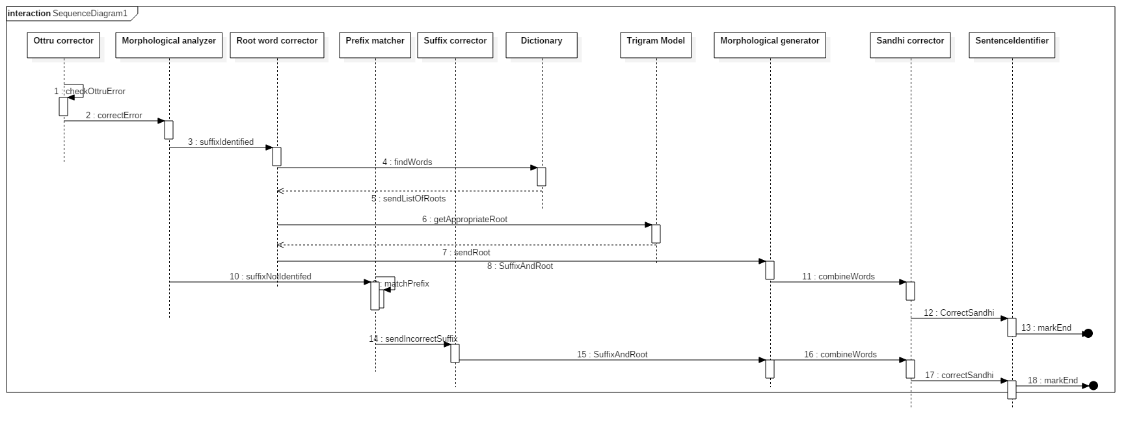
Sequence diagram

Slide 10
Ottru corrector
The text from the OCR is given to the ottru corrector.
The occurrence of Tamil consonants are identified and rules are made.
Ottru errors are corrected according to the rules.

Slide 11
Ottru corrector contd..
Prototype
Input: Words in input sentence
Output: Words with corrected ottru
Algorithm
For each sentence S in input
for each word W in S
if (ottru rule error) then
make appropriate changes
end if
end for
End for

Slide 12
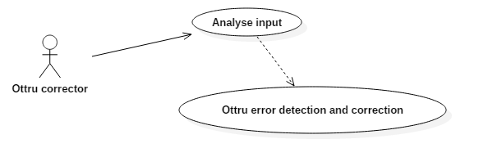
Ottru corrector contd…

Slide 13
Morphological analyzer
The Ottru corrected input is given to the morphological analyzer
This identifies possible root words and suffixes.
Additional character(s) used for joining the words are also stored to retain their original meaning
If suffix is correct it is removed and root word is obtained
If suffix is incorrect, we search from the beginning to identify longest matching prefix and suffix is corrected accordingly

Slide 14
Morphological analyzer contd
Prototype
Input: Ottru corrected input
Output: Root words and suffixes
Algorithm
for each word W
if proper suffix is found then
separate suffix and root
if error in root then
send to rootWordCorrector
end if
else
match prefix
separate matched prefix and error prone suffix
send to suffixCorrrector
end if
end for

Slide 15
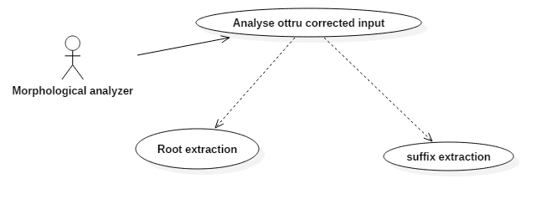
Morphological analyzer contd

Slide 16
Root word corrector
Root word obtained from the morphological analyzer will contain errors.
Root word corrector assumes that the suffix is correct
The correction can be carried out with reference to the suffixes
Levenshtein algorithm is used to list out nearest matching root words based on suffixes
The word level Tri-Gram Probabilistic model gives suggestion of root words.

Slide 17
Root word corrector contd
Prototype
Input: root word with error
Output: Corrected root word
Algorithm
check W in trigram for longest match
if found then
select appropriate word based on POS
correct the root word
end if
end

Slide 18
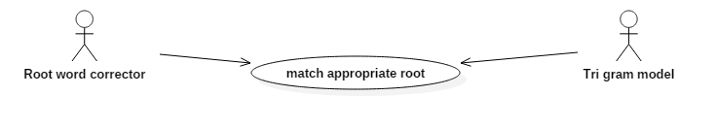
Root word corrector contd

Slide 19
Prefix matcher
We assume that if root word is not identified by morphological analyzer then the error is in the suffix
Prefix matching algorithm is used to identify the longest matching root from the beginning
The root word is processed by the root word corrector

Slide 20
Prefix matcher contd
Prototype
Input: word with erroneous suffix
Output: RootWord + Erroneous suffix
Algorithm
parse W_{n} from beginning upto W_{i}
check for matching word in dictionary
if found then W₀..W_{i} is considered a root
W_{i+1} .. W_{n-1} is considered suffix
end if
end

Slide 21
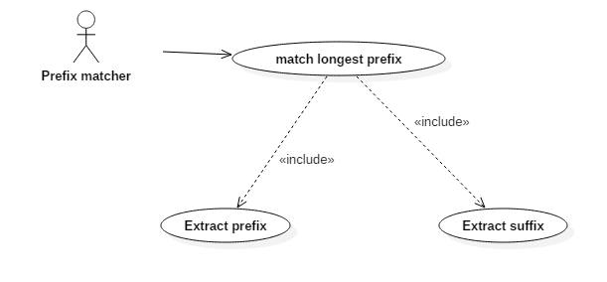
Prefix matcher contd

Slide 22
Suffix corrector
Suffixes processed by the prefix corrector are given to the suffix corrector
An automata based on Tamil grammar rules are used to validate and correct the suffix
This is because Tamil words support multiple suffixes for a given prefix

Slide 23
Suffix corrector contd
Prototype
Input: erroneous suffix
Output: Corrected suffix
Algorithm
check nearest matching Su in SuffixList SL
if found then
replace it
end if
end

Slide 24
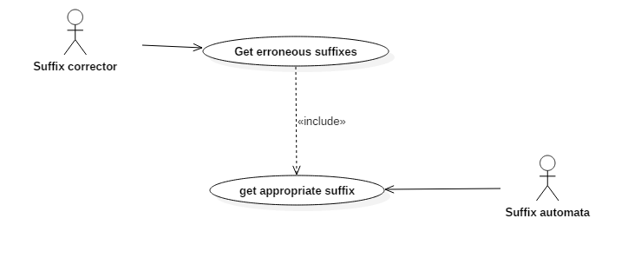
Suffix corrector contd

Slide 25
Tri-gram Model
Correct root word from the list of root words must be obtained based on the context
This can be obtained by constructing a tri gram model which determines the words based on probability of occurrence
Word based and character based tri-gram models are constructed to increase efficiency

Slide 26
Morphological generator
After determining the valid root word and correct suffix the words, Morphological generator is used to combine them to form actual word.
During the process of combining, additional characters may also be required to generate the words.
This is done based on inflectional rules in Tamil grammar

Slide 27
Morphological generator contd.
Prototype
Input: correcte suffix, corrected root word
Output: combined word
Algorithm
Get corrected rootWord and suffix
return rootWord+Suffix
end

Slide 28
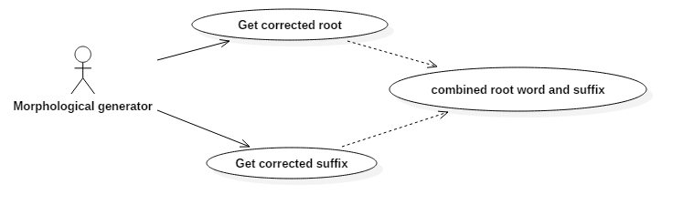
Morphological generator contd.

Slide 29
Sandhi corrector
Sandhi rules are used to correct sandhi errors.
After root word correction and suffix correction, they are joined by a sandhi.
The correct sandhi is identified by sandhi corrector.

Slide 30
Sandhi corrector
Prototype
Input: word from morphological generator
Output: Sandhi corrected word
Algorithm
for each root and suffix pair
check for appropriate sandhi using sandhi rules
if found then
insert sandhi
combine root and suffix
end if
end for

Slide 31
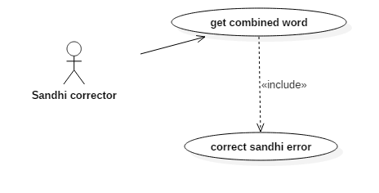
Sandhi corrector contd

Slide 32
Sentence identifier
In Tamil, sentences usually ends with Verb+…+PNG(Person Name Gender).
Sentence identifiers identifies these tags and finds the end of sentence

Slide 33
Platforms and tools used
Programming language – Java
Operating system – Windows
Tools
IDE-Netbeans
Ponvizhi- Tamil OCR Software
Tesseract (Command line)- Command line OCR from Google
Tesseract (GUI) – A GUI version of tesseract

Slide 34
Test cases
Test case id | Module | Input | Output
1 | Ottru Corrector | Words in input sentence | Ottru corrected words
2 | Morphological analyzer | Ottru corrected input | Root words and suffixes
3 | Root word corrector | Root word with error | Corrected root word
4 | Prefix matcher | Word + erroneous suffix | Root Word + erroneous suffix
5 | Morphological generator | Corrected word + Corrected suffix | Combined word
6 | Sandhi corrector | Word from morphological analyzer | Sandhi corrected word

Slide 35
References
Rajeswari Sridhar, Remitha Rathi L, Rithya P, Nivrutha P “Use of Tamil Grammar Rules for Correcting Errors in Optical Character Recognized Document” ,proposed at 12th international Tamil Internet Conference,2013
http://en.wikipedia.org/wiki/Levenshteindistance.
http://www.cs.columbia.edu/~julia/courses/CS4705/ngrams.ppt
https://en.wikipedia.org/wiki/Tesseract

